Slide 1

Deep Learning
Session 5
Training Neural Networks
Applied Data Science
2024/2025

Slide 2
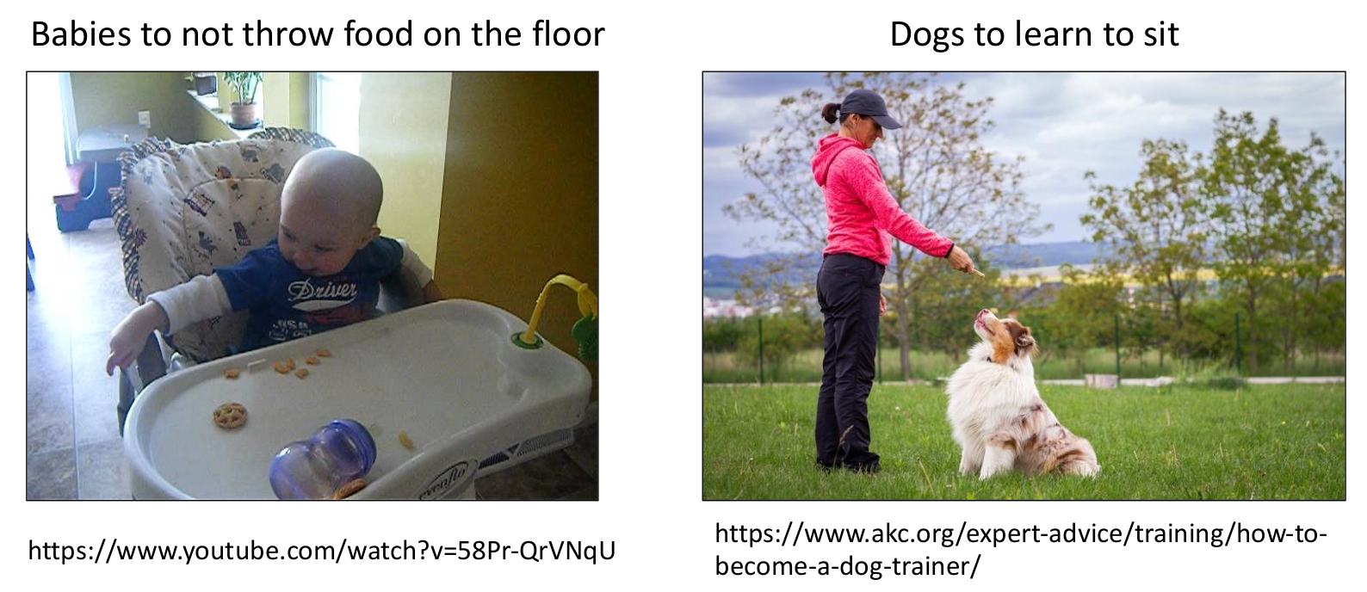
Objective Function: Analogous to Training
Training Neural Networks
Session 5

Slide 3
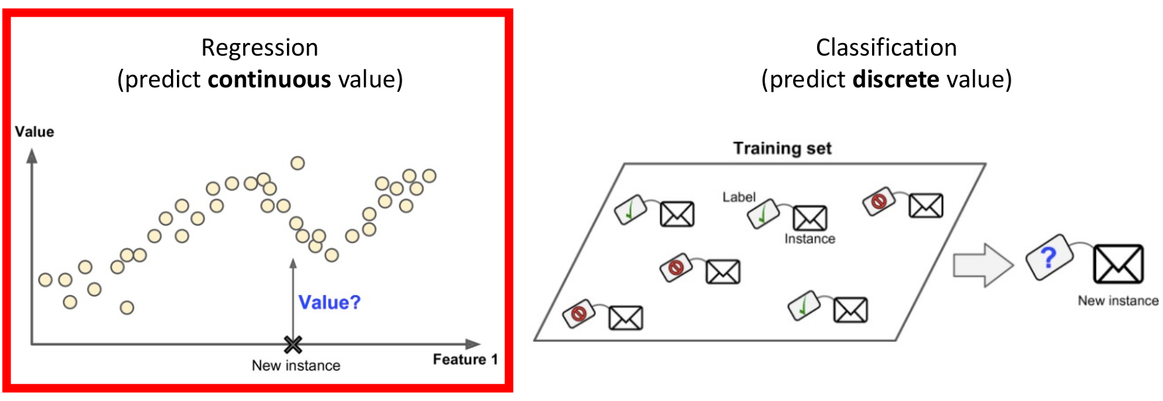
Objective Function: Learn Model Parameters that Achieve a Specified Goal
Training Neural Networks
Session 5

Slide 4
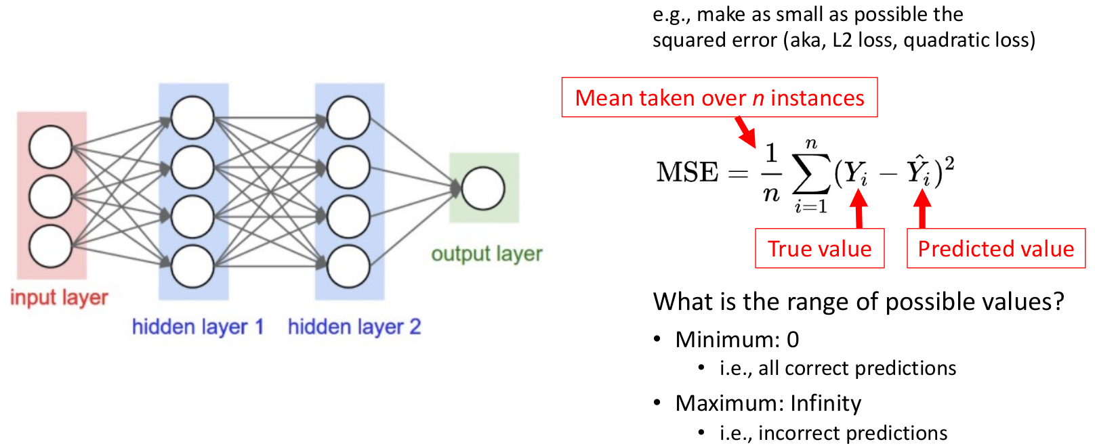
Objective Function: Learn Model Parameters that Achieve a Specified Goal
Training Neural Networks
Session 5

Slide 5
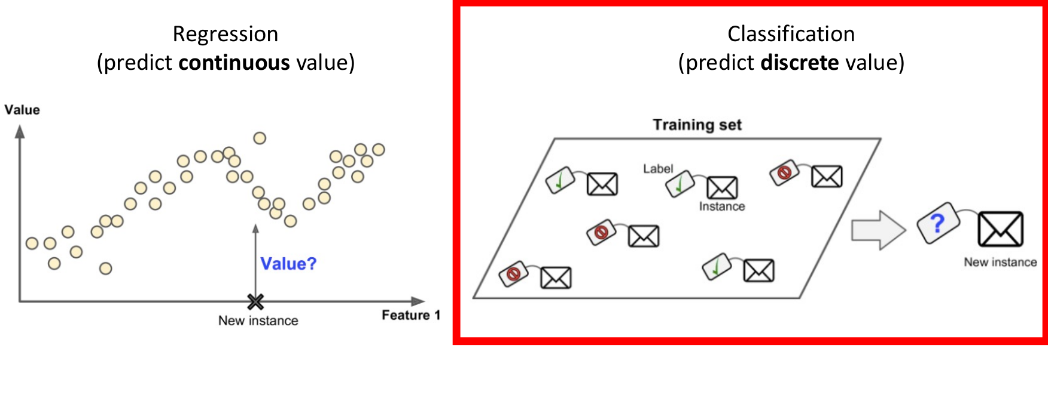
Objective Function: Learn Model Parameters that Achieve a Specified Goal
Training Neural Networks
Session 5

Slide 6
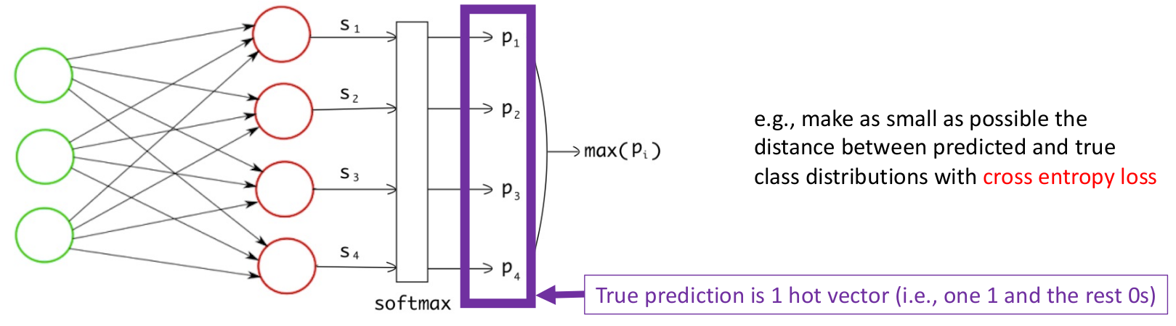
Objective Function: Learn Model Parameters that Achieve a Specified Goal
https://towardsdatascience.com/multi-label-image-classification-with-neural-network-keras-ddc1ab1afede
Training Neural Networks
Session 5

Slide 7
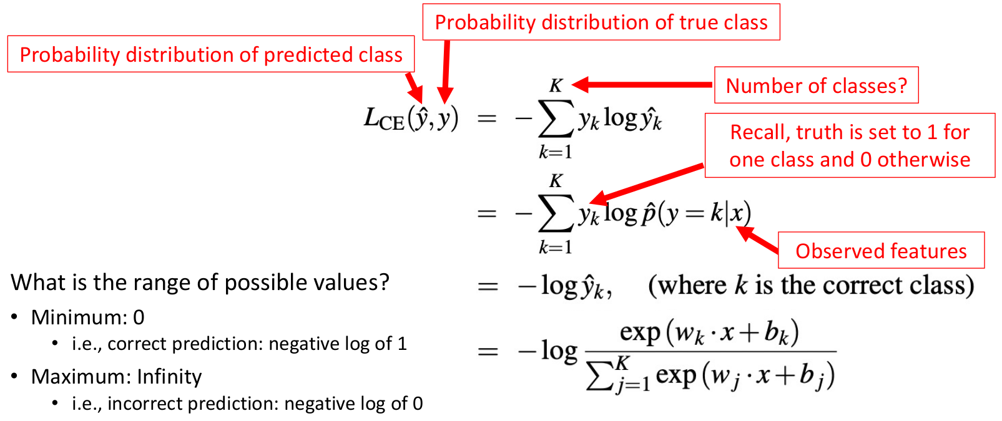
Objective Function: Learn Model Parameters that Achieve a Specified Goal
Training Neural Networks
Session 5

Slide 8
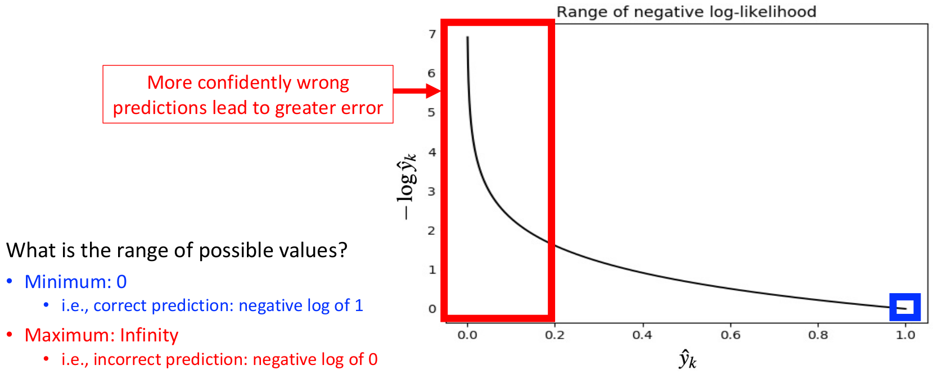
Objective Function: Learn Model Parameters that Achieve a Specified Goal
Training Neural Networks
Session 5

Slide 9
Objective Function
Loss Functions
Regression
MSE
RMSE
Classification
Binary Crossentropy
MAE
Hubber Loss
Categorical Crossentropy
Hinge Loss
Many objective functions exist, and we will explore popular ones in this course!
Training Neural Networks
Session 5

Slide 10
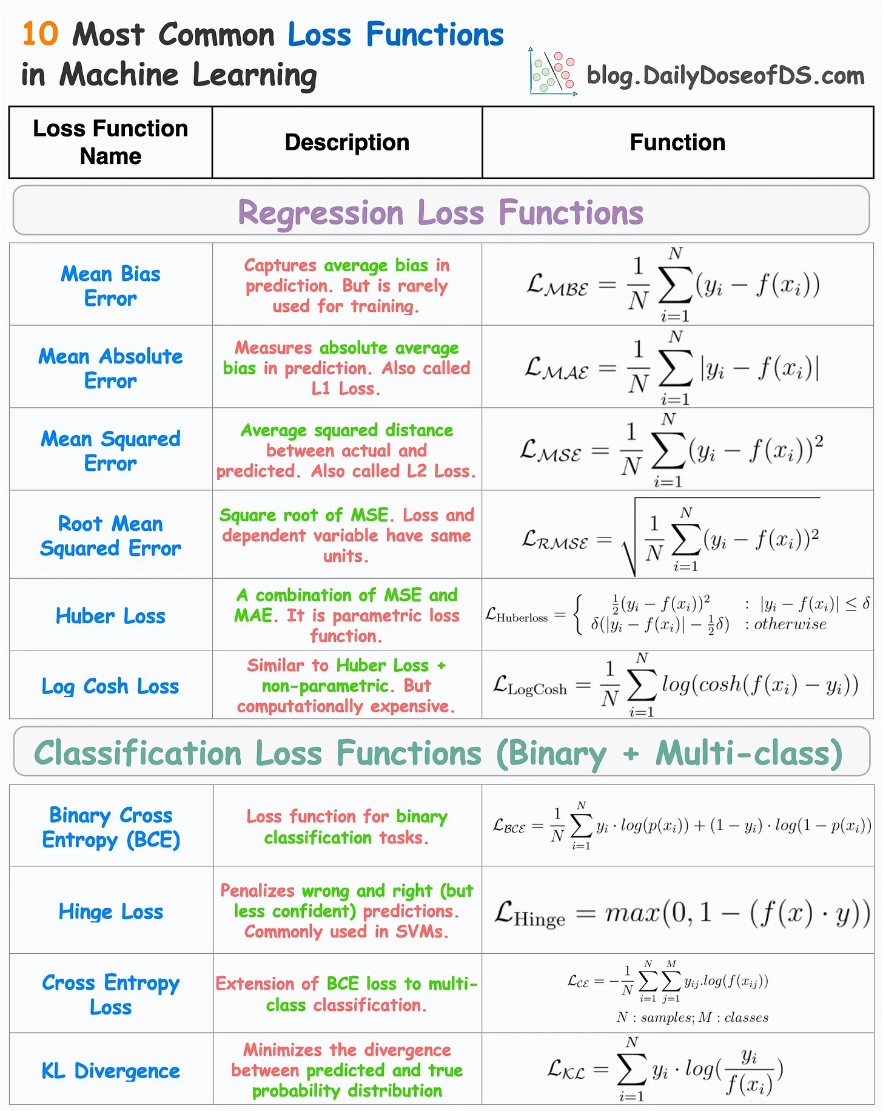
Loss Functions
https://blog.dailydoseofds.com/p/10-regression-and-classification
Training Neural Networks
Session 5

Slide 11
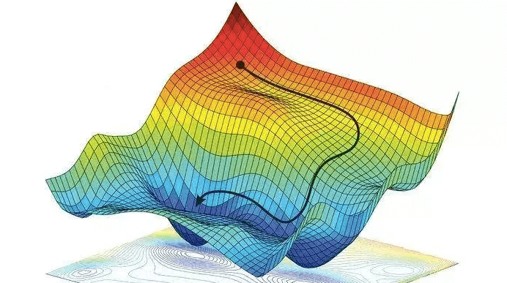
Gradient Descent: How to Learn?
Training Neural Networks
Session 5

Slide 12
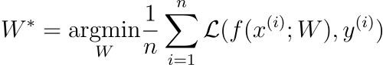
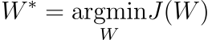
Loss Optimization
We want to find the network weights that achieve the lowest loss!
Training Neural Networks
Session 5

Slide 13
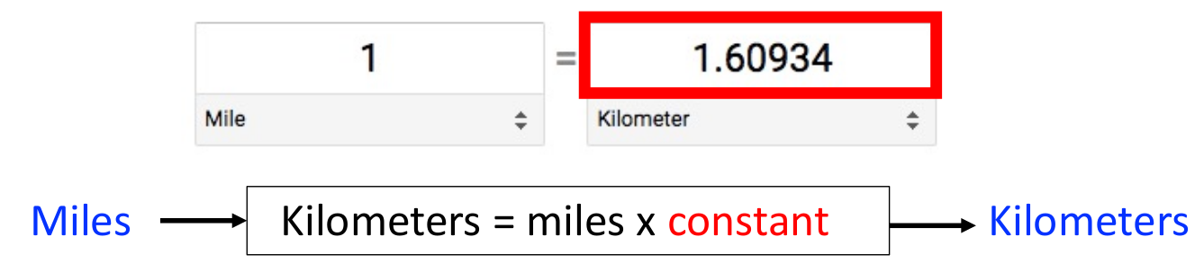
Gradient Descent: Intuition
Repeat:
Guess
Calculate error
e.g., learn linear model for converting kilometers to miles when only observing the input “miles” and output “kilometers”
Training Neural Networks
Session 5

Slide 14
Gradient Descent: Intuition
Repeat:
Guess
Calculate error
1
Training Neural Networks
Session 5

Slide 15

Gradient Descent: Intuition
Repeat:
Guess
Calculate error
1
Training Neural Networks
Session 5

Slide 16
Gradient Descent: Intuition
Repeat:
Guess
Calculate error
1.5
Training Neural Networks
Session 5

Slide 17
Gradient Descent: Intuition
Repeat:
Guess
Calculate error
Idea: iteratively adjust the constant (i.e., model parameter) to try to reduce the error
1.5
Training Neural Networks
Session 5

Slide 18
Gradient Descent: Intuition
Iteratively search for values that solve optimization problem (i.e., minimize or maximize an objective function)
When minimizing the objective function, it also is often called interchangeably the cost function, loss function, or error function.
Training Neural Networks
Session 5

Slide 19
Gradient Descent: Intuition
Idea: use derivatives!
Derivatives tell us how a small change in the input 𝑥 affects the output 𝑓(𝑥).
Specifically, the derivative 𝑓′(𝑥) represents the rate of change of the function at a given point, indicating how much 𝑓(𝑥) will change in response to a small change in 𝑥.
Gradient is a vector that indicates how 𝑓(𝑥) changes as each function variable changes (i.e., partial derivatives).
Training Neural Networks
Session 5

Slide 20
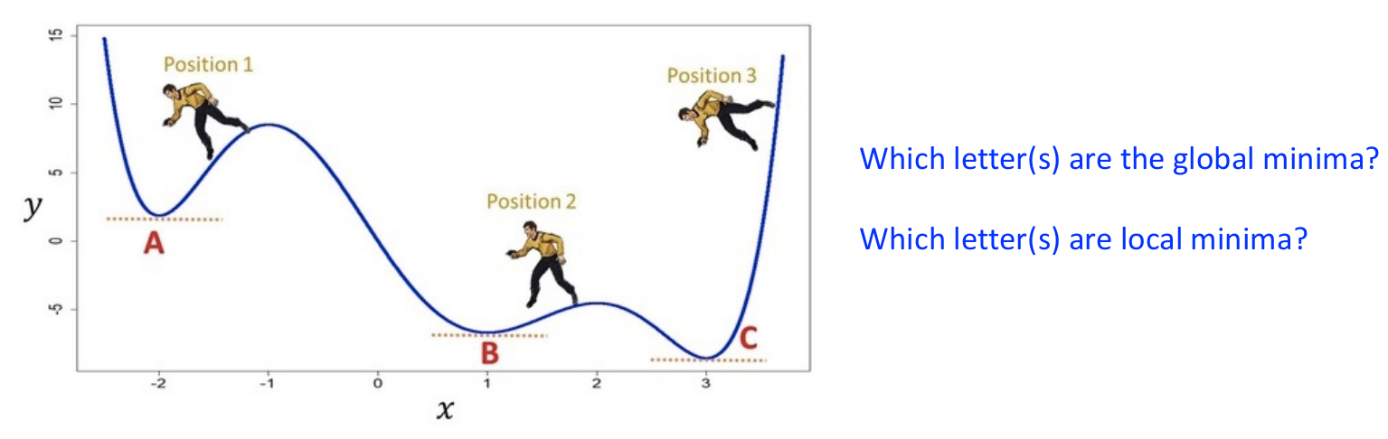
Gradient Descent: Intuition
Gradient descent:
Iteratively take steps in the opposite direction of the gradient to minimize the function
Training Neural Networks
Session 5

Slide 21
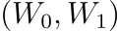
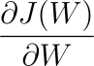
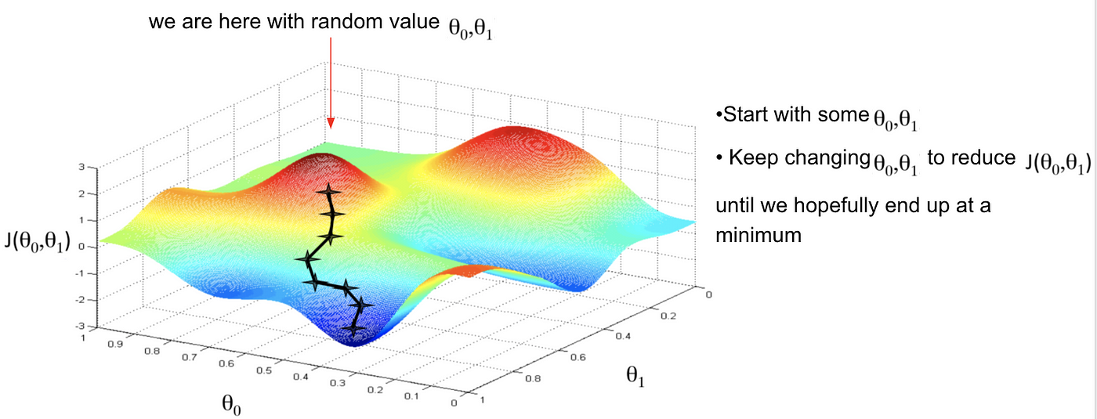
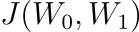
Gradient Descent
Randomly pick an initial
2. Compute the gradiente:
3. Take a small step in the opposite direction of the gradient.
4. Repeat until convergence.
Training Neural Networks
Session 5

Slide 22
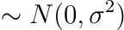
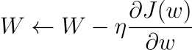
Gradient Descent
Algorithm:
Initialize weights randomly
Loop until convergence
Compute gradient
Update weights
Return weights
Training Neural Networks
Session 5

Slide 23
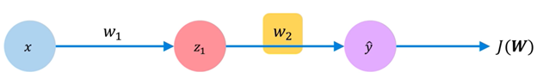
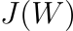
Computing Gradients: Backpropagation
How does a small change in one weight (e.g., ) affect the final loss ?
Training Neural Networks
Session 5

Slide 24
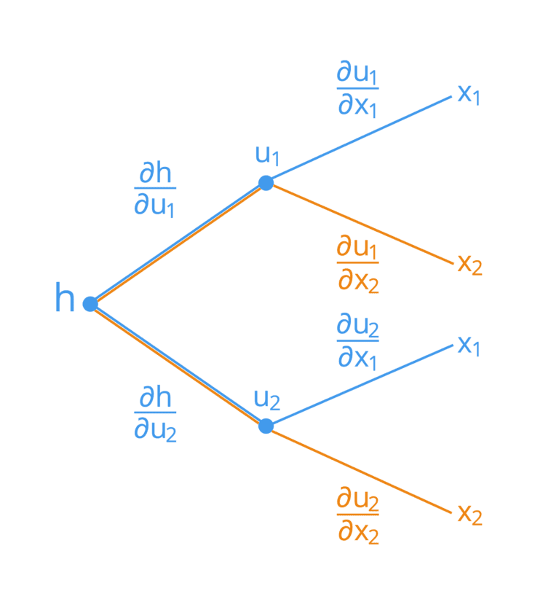
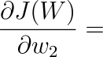
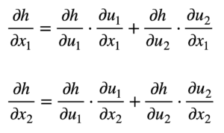
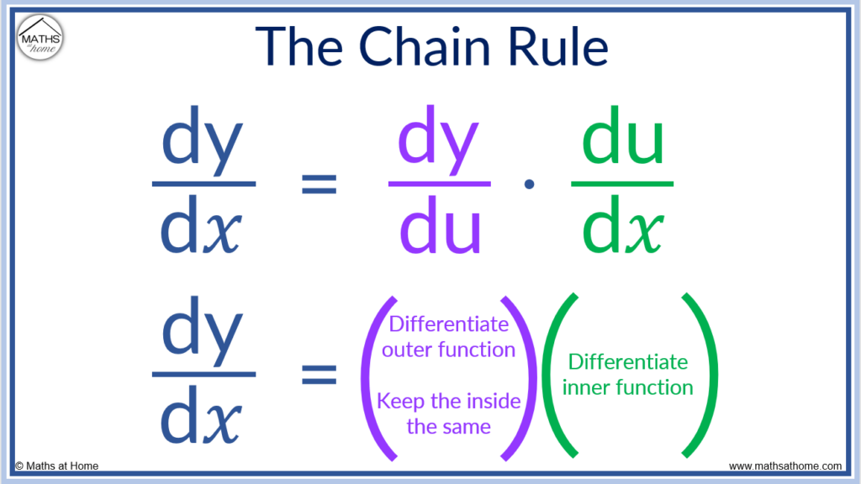
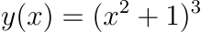
Computing Gradients: Backpropagation
?
Let's use the chain rule!
Training Neural Networks
Session 5

Slide 25
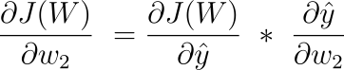
Computing Gradients: Backpropagation
Training Neural Networks
Session 5

Slide 26
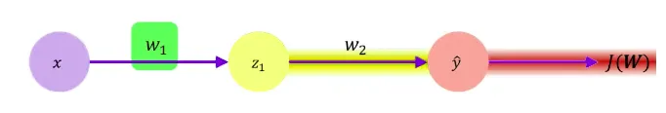
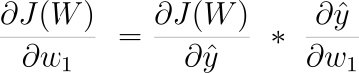
Computing Gradients: Backpropagation
Apply the chain rule!
Apply the chain rule!
Training Neural Networks
Session 5

Slide 27
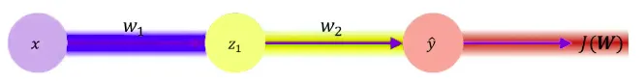
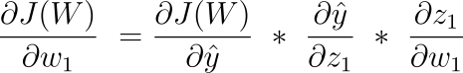
Computing Gradients: Backpropagation
Training Neural Networks
Session 5

Slide 28
Computing Gradients: Backpropagation
Repeat this for every weight in the network using gradients from later layers.
Training Neural Networks
Session 5

Slide 29
Gradient Descent: How Often to Update?
Batch Gradient Descent:
Uses all training examples in each update
Less noisy updates but slow or infeasible for large datasets
Stochastic Gradient Descent (SGD):
Updates with a single example per iteration
Fast and memory-efficient for large datasets, but updates can be noisy
Mini-batch Gradient Descent:
Updates with a subset of examples per iteration
Reduces noise compared to SGD, scalable to large datasets, but can still be slow with large data
Training Neural Networks
Session 5

Slide 30
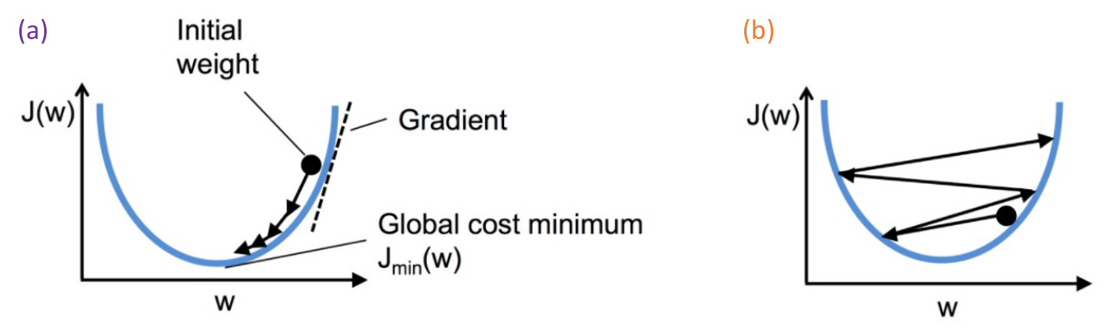
Gradient Descent: How Much to Update?
Step size = learning rate
(a) When learning rate is too small, convergence to good solution will be slow!
(b) When learning rate is too large, convergence to a good solution is not possible!
Training Neural Networks
Session 5

Slide 31
Gradient Descent: How to Choose the Learning Rate?
Idea 1
Try lots of different learning rates and see what works better!
Training Neural Networks
Session 5

Slide 32
Gradient Descent: How to Choose the Learning Rate?
Idea 3
Do something smarter!
Design na adaptive learning rate that "adapts" to the landscape!
Training Neural Networks
Session 5

Slide 33
Adaptive Learning Rates
Learning rates are no longer fixed!
Can be made larger or smaller depending on:
How large the gradient is.
How fast learning is happening.
The size of particular weights.
etc...
Training Neural Networks
Session 5

